Slide 1
Hmmm..
aka. Agi Ronay’s First Demo

Slide 2
What will I talk about?
Why I am here
„Background”
What I learned
Challenges
Example

Slide 3
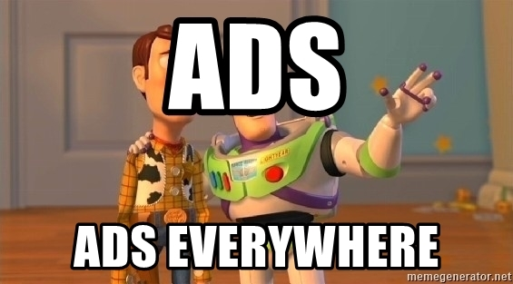
Why am I here?
Employment trends
ADS!!!!44!!

Slide 4


„„Background””
Notes:
Played with HTML when I was a kid :D
Started Python at home, alone → what I learned alone took a lot longer than here :’D

Slide 5

What I learned:
Everything
HTML & CSS
GIT & VSC

Slide 6
The first challenges
(Waking up 5 times a week)
{ }
VSC errors
Thinking before acting (and trying aimlessly..)

Slide 7
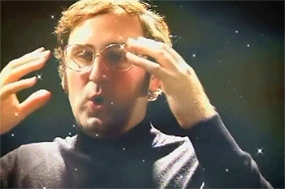
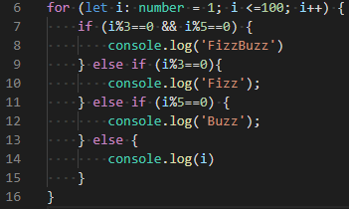
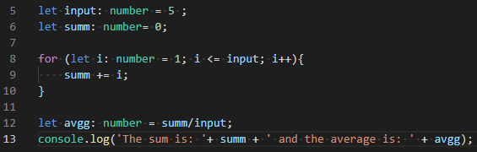
Example of enlightenment
Notes:
Parametric average → fizz buzz

Slide 8
Thank you for your attention! ☺

